Slide 1
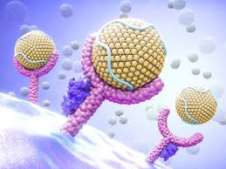
University of Basrah
Al-Zahraa College of Medicine
Ministry of higher Education
and Scientific Research
MEMBRANES AND RECEPTORS MODULE
SESSION : 3
DATE: 22nd Dec. 2020
RESTING MEMBRANE POTENTIAL
Module staff:
Dr. Raghda S. Al-Najjar
Dr. Nehaya M. Al-Aubody
(module leader)
Dr. Hamid J. Abbas
Dr. Raghad Mohammed
Dr. Hssain Abdulamer
Dr. Ammar M.S. Almomin
Dr. Ahmed J.A. Al-ali
Dr. Maida A. Adnan
Dr. Hadeel S. Al Ali
Dr.Amani N. Mohammed
Dr.Dhaighum I. Al-Mahfoodh
Dr. Ansam Munadhel
Dr. Zainab A. Almanaser
2016_Guyton_and_Hall_Text book of Medical Physiology_Page61
Pictures are downloaded from a common distributive source.

Slide 2
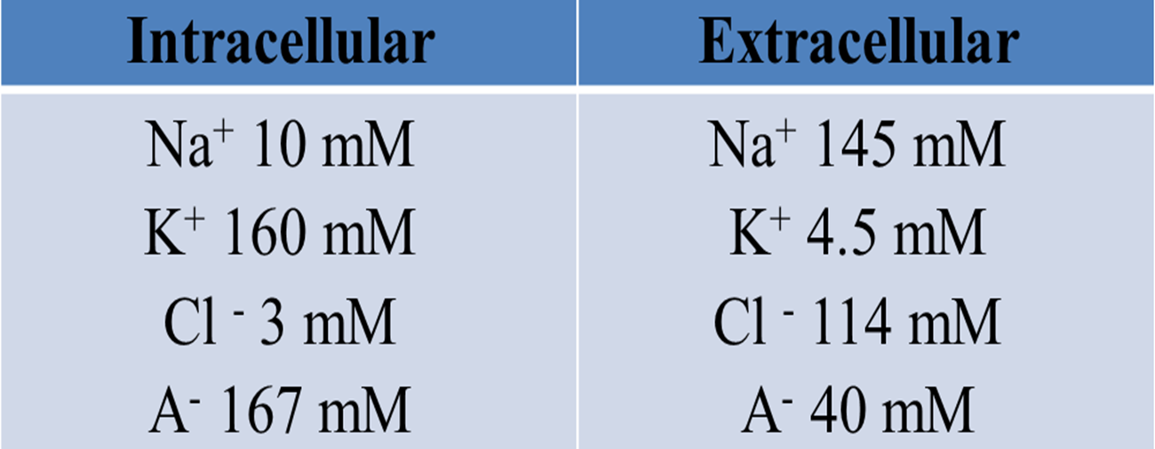

Slide 3
EXERCISE 1.
a) What is responsible for the unequal distribution of inorganic ions between the intracellular and extracellular fluid?
b) Resting cell membranes are selectively permeable to K+. Given the concentration gradient that exists across the plasma membrane, which direction would you predict that K+ ions will move?

Slide 4
c) What effect will this have on membrane potential and why?
d) Using the Nernst equation, calculate the K+ equilibrium potential (EK) for cells with intra- and extracellular fluid compositions as given in the Table above.

Slide 5
e) The actual membrane potential of a nerve cell, when measured with a microelectrode, was found to be -75 mV. Why was the measured membrane potential different to that calculated for EK?
f) What would happen to the membrane potential if there was an increase in the permeability of the membrane to K+ ions ?
g) What contribution does the Na+-K+-ATPase make to the maintenance of the resting membrane potential?

Slide 6
EXERCISE 2.
a) Replace Cl- for K+ in the Nernst equation and calculate the chloride equilibrium potential (EBClB). Note: the charge on the ion being considered is negative. This should be taken into consideration in your calculation.
b) What can you conclude when comparing ECl with EK ? What contribution does Cl- permeability makes in nerve cells to fixing membrane potential (relative to that of K+)?
c) Some neurotransmitters act to increase Cl- conductance in the postsynaptic cell. What are the consequences of an increased Cl- conductance for the membrane potential.

Slide 7
EXERCISE 3.
a) Calculate ENa
b) During the initial phase of the action potential (electrical impulse involved in electrical excitation) in nerve and muscle plasma membranes the Na+ permeability increases so much that it becomes very much higher than that of K+. What can you predict in relation to the membrane potential ?

Slide 8
c) The membrane potential is restored rapidly to resting levels in nerve and muscle cells after an action potential. How do you think how this is achieved?
d) What do you predict would be the effect on membrane excitability of increasing the permeability to Cl- ions?

Slide 9
EXERCISE 4.
a) Calculate ECa. Note: the valency of Ca2+ is +2. This should be taken into consideration in your calculation.
b) During the heartbeat, myocardial Ca2+ channels open and result in a substantial increase in Ca2+ permeability. In which direction does the Ca2+ flow ?

Slide 10
EXERCISE 5.
a) In a hyperkalaemic patient, the plasma K+ concentration was found to be 7.5 mM. Assuming a similar value for the interstitial fluid, what would the consequences be for the resting cell membrane?
b) Predict what the clinical consequences of such a changes might be.

